Slide 1
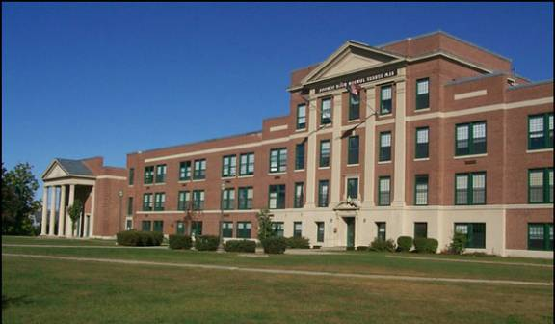
Pictures of class members
Class of 1961

Slide 2
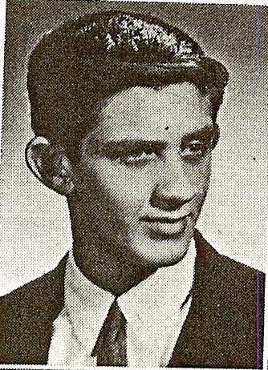
Douglas adams May 3, 2016
Notes:
Adams, Douglas 35 Pierce Lane Hollis, NH 03049 May 3, 2016

Slide 3
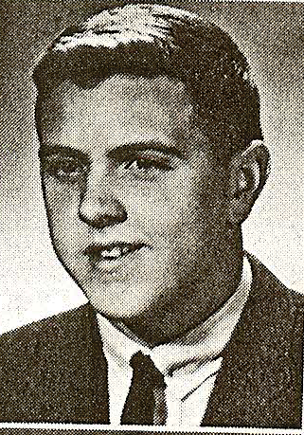
williaM AFFLEDT
Notes:
Affeldt, William 10305 Newberry Park Lane Charlotte, NC 28277-2338 704 544-0754 cell: 704 962-1132 baffeldt@carolina.arr.com

Slide 4
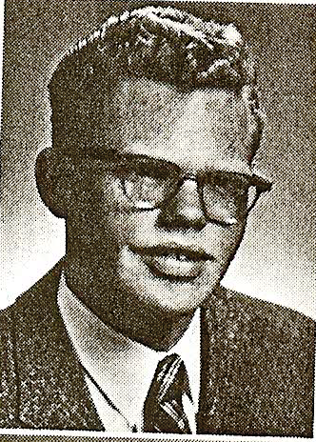
DAIVD AINSWORTH
Notes:
Ainsworth, David C 57 Linton Street Nashua, NH 03060 603 888-2536 bigwavedavea@yahoo.com

Slide 5
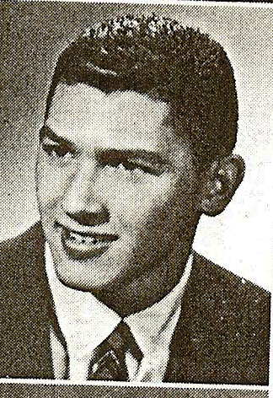
ERNEST ANASTOS
Notes:
Anastos, Ernest P 8 Fawn Lane Armonk, NY 10504 212 452-3767 eabelair@aol.com

Slide 6
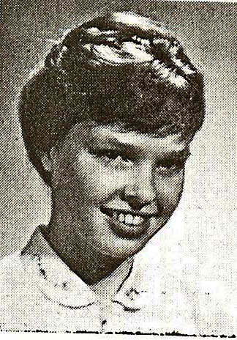
PEGGY APONOVICH
Notes:
Aponovich, Peggy L (Morin) 4 Gauthier Road Merrimack, NH 03054 603 883-2780 rbmpm@comcast.net

Slide 7
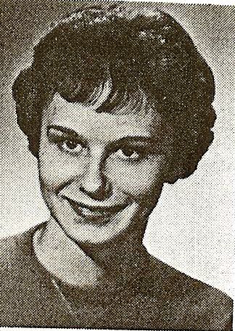
ORMA ARLAUSKAS
Notes:
Arlauskas, Orma (Thompson) RR1 Box 263C Newport, NH 03773 603 863-1939 jthompson@sugar-river.net

Slide 8
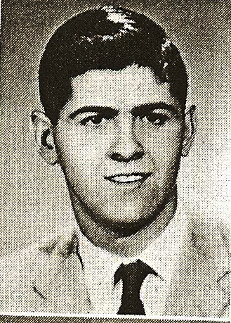
MAURICE AUBUT
Notes:
Aubut, Maurice R 216 Par Pines Boulevard Davenport, FL 33837-1501 321 624-5919 mary.aubut@gmail.com

Slide 9
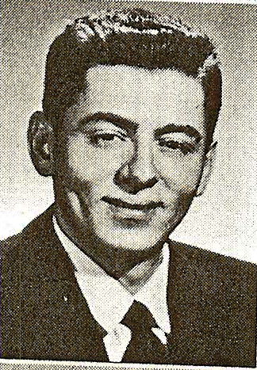
REMI AUBUT
Notes:
Aubut, Remi P 101 Burke Street #220 Nashua, NH 03060 603 889-2972 aubutremi@aol.com

Slide 10
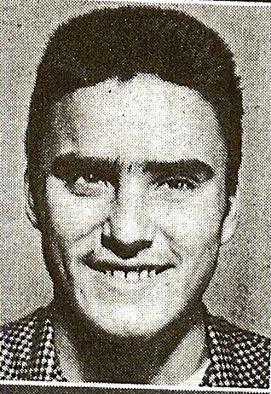
RALPH AUSTIN December 24, 2013
Notes:
Austin, Ralph S no data

Slide 11
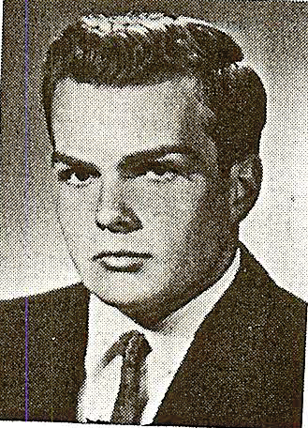
DOUGLAS AYER March 23, 1989
Notes:
Ayer, Douglas E DECEASED - March 23, 1999

Slide 12
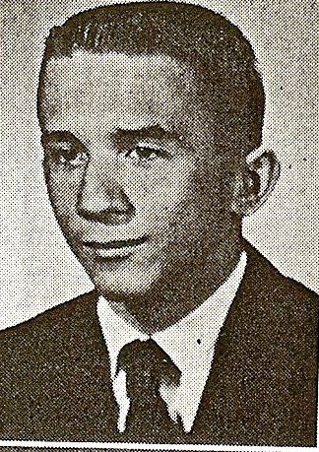
RONALD Barrett
Notes:
Barrett, Ronald 3 Moe Street Nashua, NH 03062 603 598-3863

Slide 13
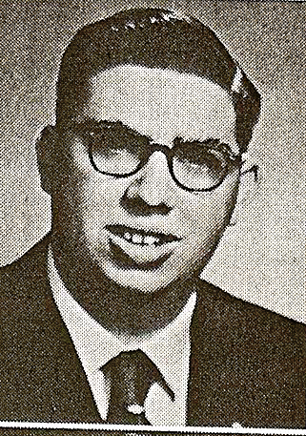
Edward barron
Notes:
Barron, Edward D 140 CR 1130 Cullman, AL 35057 256 734-6997 edanddianne@yahoo.com

Slide 14
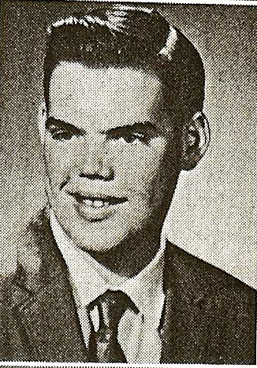
Ronald barron
Notes:
Barron, Ronald P 93 E Hobart Street Nashua, NH 03060 603 888-2075

Slide 15
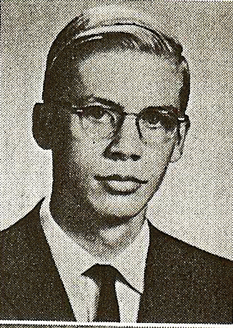
David barry January 28, 2002
Notes:
Barry, David W DECEASED - January 28, 2002

Slide 16
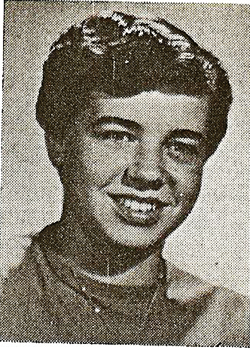
Candace bates
Notes:
Bates, Candace C (Allard) 459 St. Johns Drive Satellite Beach, FL 32937-4023 321 779-2941 racezone@aol.com

Slide 17
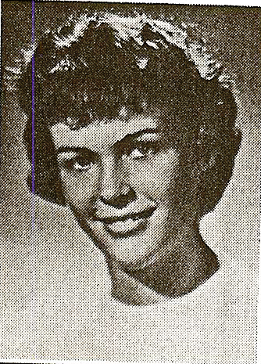
Beverlee baxter
Notes:
Baxter, Beverlee (White) 550 Manorwood Lane Louisville, CO 80027-3239 Home: 303 945-4167 Cell: 703 978-7653 beverleewhite@comcast.net

Slide 18
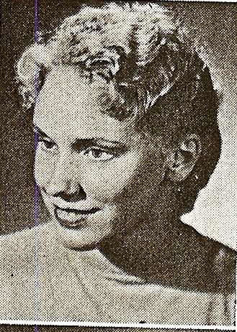
Candace beach
Notes:
Beach, Candace Friborg 598 Back Mountain Road Goffstown, NH 03045 603 497-2671

Slide 19
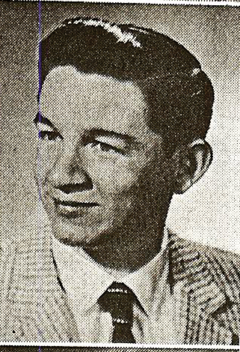
Harold beaubien
Notes:
Beaubien, Harold 1449 Hollyberry Place The Villages, FL 32162 Home: 352 259-1294 Cell: 603 769-0569 leftybeaubien@hotmail.com

Slide 20
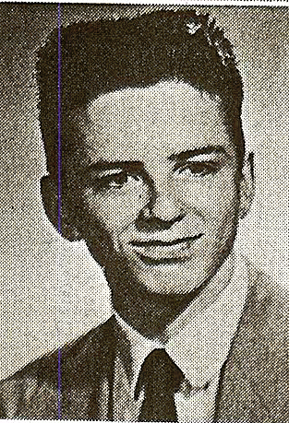
Rodney bechard
Notes:
Bechard, Rodney D 5667 Amalie Drive Nashville, TN 37211-5910

Slide 21
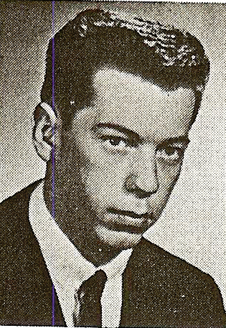
Romeo bedard
Notes:
Bedard, Romeo R (Dick) Winter: 1363 Bethune Way Summer: 12336 Hickory Ct Winter: The Villages, FL 32162 Summer: Huntley, IL 60142 847 515-8055 Cell: 847 997-0997 bedardmail@yahoo.com

Slide 22
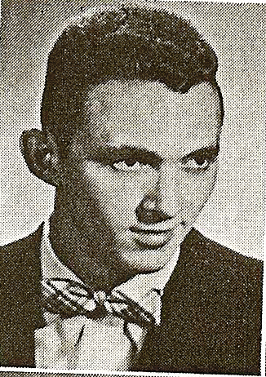
Fred belanger
Notes:
Belanger, Fred M 500 Feathermoon Drive Santa Teresa, NM 88008 505 589-9737

Slide 23
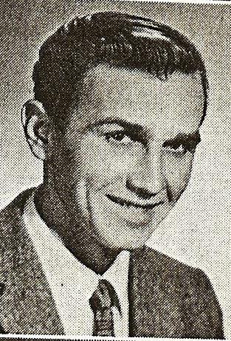
Noel belanger
Notes:
Belanger, Noel R 204 Nash Street Hot Springs, AR 71913 501 623-7004

Slide 24
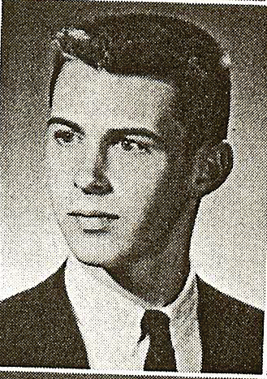
Samuel bellavance
Notes:
Bellavance, Samuel P 103 Northwest Boulevard Nashua, NH 03063 603 882-9722 sam.bellavance@bellavancebev.com

Slide 25
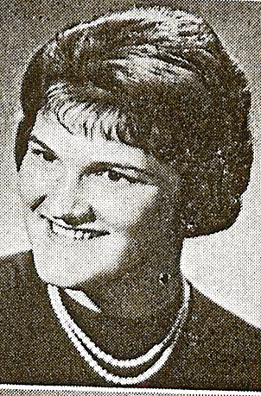
Elizabeth Bentley May 23, 2000
Notes:
Bentley, Elizabeth (D'Angelo) DECEASED - May 23, 2000

Slide 26
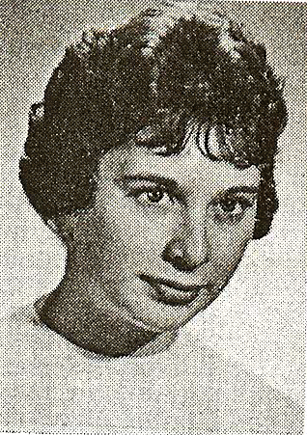
Constance bertrand
Notes:
Bertrand, Constance (Swakla) 10919 SW 69th Circle Ocala, FL 34476-5735 352 861-9805 connieswakla@embarqmai

Slide 27
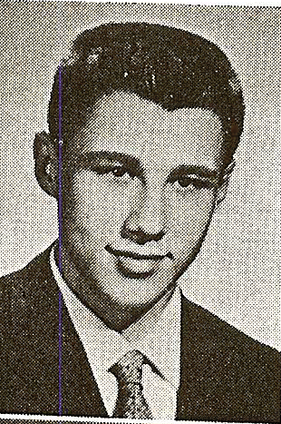
Donald berube
Notes:
Berube, Donald J 19 Hassle Brook Road Nashua, NH 03060 603 791-4970

Slide 28
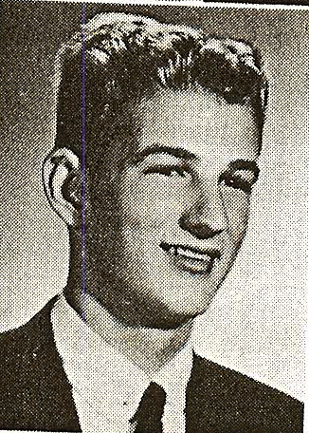
Ralph berube
Notes:
Berube, Ralph H 42 Coles Grove Road Derry, NH 03038 603 552-3295 angel4ms@roadrun

Slide 29
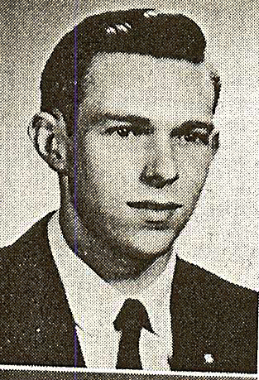
Harold bickford
Notes:
Bickford, Harold

Slide 30
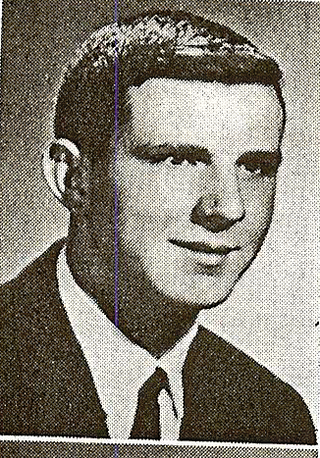
Thomas bilodeau May 6, 2013
Notes:
Bilodeau, Thomas H 2 Hemlock Street Hampton, NH 03842 603 926-9556

Slide 31
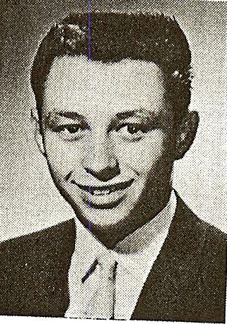
Richard blanchette
Notes:
Blanchette, Richard L 1305 North Beach Street Ormond Beach, FL 32174 386 672-1305 datadoc1@att.net

Slide 32
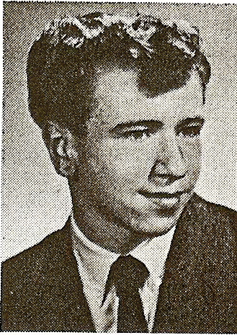
Gerard bloiin
Notes:
Blouin, Gerard R 2 Ducas Avenue Nashua, NH 03063 603 881-5830 sueatfoth@gmail.com

Slide 33
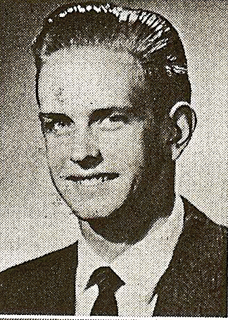
Dennis boggis
Notes:
Boggis, Dennis 18 Merlin Place Londonderry, NH 03053-3952 603 432-3150 pboggis_pb1@comcast.net

Slide 34
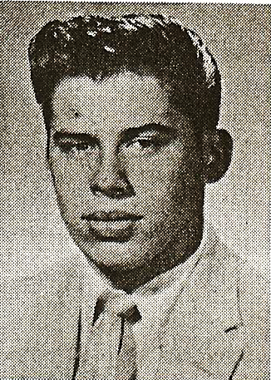
Ronald bonenfant June 7, 2008
Notes:
Bonenfant, Ronald E DECEASED - June 7, 2008

Slide 35
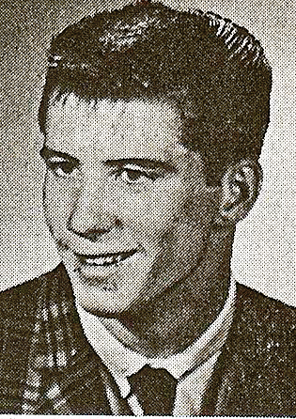
George boucher
Notes:
Boucher, Geroge H 2412 Old Oak Trail Brooksville, FL 34604 508 942-2534 ghb960@hotmail.com

Slide 36
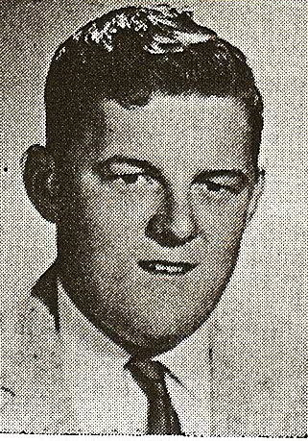
Paul boucher April 30, 1999
Notes:
Boucher, Paul A DECEASED - April 30, 1999

Slide 37
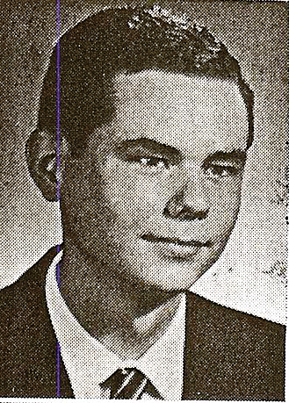
Peter boucher
Notes:
Boucher, Peter (Reverend) St. Patrick and St. Joachim Parishes 32 Beech Street Newport, NH 03773-1416 603 224-4393 pbushsem@aol.com

Slide 38
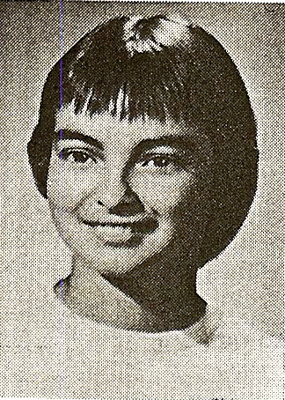
Diane bourdon
Notes:
Bourdon, Diane (Hambleton) 2509 Kaitlyn Drive Bloomington, IL 61704-3435 309 585-0279 Phambleton@aol.com

Slide 39
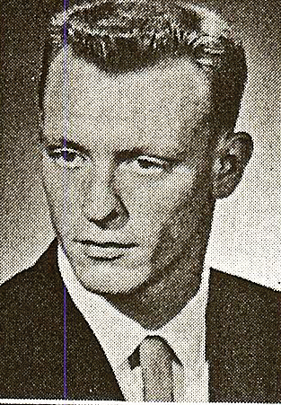
George bowman
Notes:
Bowman, George 75 Pembroke Road Concord, NH 03301 603 228-3150 annandgeorgeb86@comcast.net

Slide 40
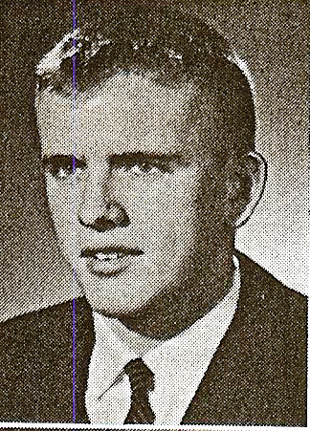
Richard brandt
Notes:
Brandt, Allen A 219 Atlantic Avenue North Hampton, NH 03862 603 964-8692 rabrandt1@comcast.net

Slide 41
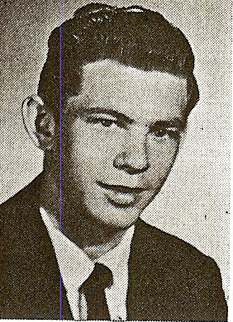
Raymond breault
Notes:
Breault, Raymond A 1637 Linkside Drive Atlantic Beach, FL 32233 904 241-2307 ray.breault@comcast.net

Slide 42
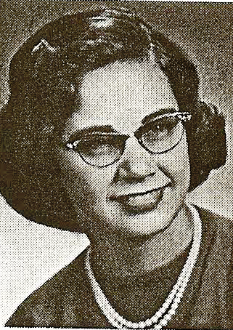
Eva briand
Notes:
Briand, Eva (Mack) 235 Wilson Crossing Road Auburn, NH 03032 603 624-5747 elmack47@comcast.net

Slide 43
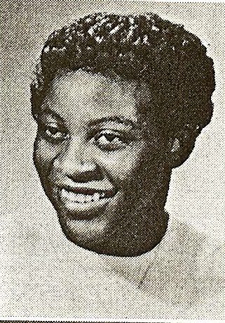
Ellen briggs October 15, 2013
Notes:
Briggs, Ellen L (Newman) 24 Cox Street Nashua, NH 03060 603 889-3258

Slide 44
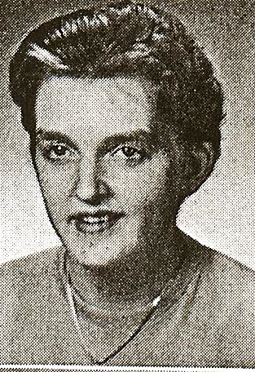
Barbara britton
Notes:
Britton, Barbara (LeBlond) 2 Nora Road Merrimack, NH 03054-4565 603 889-1712 Barb28Paws@aol.com

Slide 45
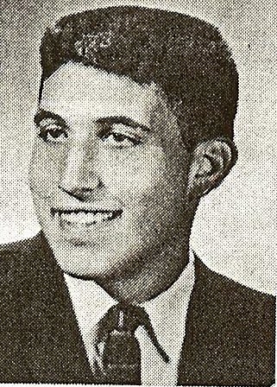
Arnold brody
Notes:
Brody, Arnold R 1910 Glenmartin Drive Raleigh, NC 27615 919 513-7662 Cell: 919 961-2038 arbrody@ncsu.edu

Slide 46
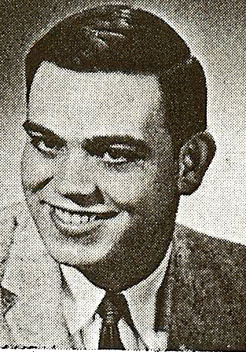
Albert budro December 15, 2004
Notes:
Budro, Albert N DECEASED - December 16, 2004

Slide 47
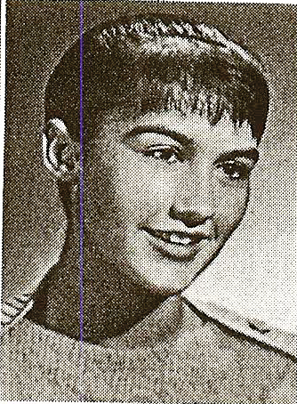
Sally burelle June 12, 203
Notes:
Burelle, Sally (Hastings) DECEASED - June 12, 2003

Slide 48
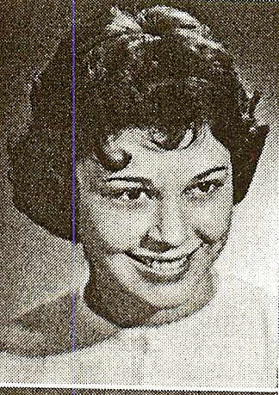
Donna burns
Notes:
Burns, Donna L (Phillips)

Slide 49
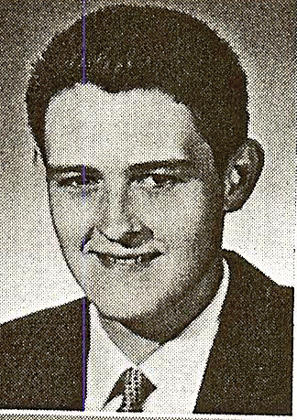
Joseph burrows
Notes:
Burrows, Joseph B 4853 Clayton Road Kathleen, FL 33849 863 206-9275 hbjbbur65@yahoo.com

Slide 50
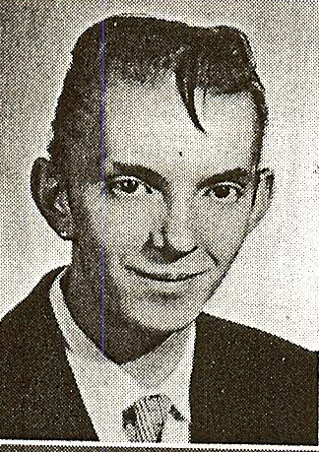
Rene cadieux
Notes:
Cadieux, Rene CANADA

Slide 51
Claudette caron
Notes:
Caron, Claudette C (Piscopo) 66 Back River Road Merrimack, NH 03054 603 424-2438 pennich@juno.com

Slide 52
Pauline caron
Notes:
Caron, Pauline M (Erickson) 30 Pershing Street Nashua, NH 03060 603 889-2863 livefreetoride@aol.com

Slide 53
John carter July 19, 2009
Notes:
Carter, John R (Jack) DECEASED - July 19, 2009

Slide 54
Joanne charpentier
Notes:
Charpentier, Joanne 11 West Glenwood Street Nashua, NH 03060 603 888-0649 charpjo@aol.com

Slide 55
Raymond chartrain
Notes:
Chartrain, Raymond C Winter: 9521 Mulligan Lane Summer: PO Box 124 Lakeland, FL 33810-4328 Shapleigh,ME 04076 603 204-8439 Rchartrain@aol.com

Slide 56
Gerald chenard March 9, 2009
Notes:
Chenard, Gerald M DECEASED - March 9, 2009

Slide 57
Edward clark March 20, 1969
Notes:
Clark, Edward G DECEASED - March 20, 1969

Slide 58
John collins
Notes:
Collins, John E

Slide 59
Martin coronis July 11, 1967
Notes:
Coronis, Martin J DECEASED - July 11, 1967

Slide 60
Carol corriveau
Notes:
Corriveau, Carol A (Hann) 1 Windham Drive Concord, NH 03301 603 225-8146 c.hann@comcast.net

Slide 61
Richard corriveau August 20, 1964
Notes:
Corriveau, Richard D DECEASED - August 20, 1964

Slide 62
Sandra corson November 3, 1996
Notes:
Corson, Sandra (Dion) DECEASED - November 3, 1996

Slide 63
Susan cote
Notes:
Cote, Susan C (Blouin) 15 Lovell Street Nashua, NH 03060 603-882-2739 sblouin@netzero.com

Slide 64
Peter cross October 31, 2004
Notes:
Cross, Peter R DECEASED - December 5, 2009

Slide 65
Everett crosscup
Notes:
Crosscup, Everett A 10 Fowell Avenue Nashua, NH 03060 603 886-9711 ECrosscup@aol.com

Slide 66
Helen cyr
Notes:
Cyr, Helen M (Clements) 176 Dogwood Road Peeskill, NY 10566

Slide 67
Shirley czarnionka
Notes:
Czarnionka, Shirley A (Drouin) 1829 Muchacha Drive Henderson, NV 89014 702 435-0877 Sacsad1031@aol.com

Slide 68
Nicholas dahl October 26, 2003
Notes:
Dahl, Nicholas T DECEASED - October 26, 2003

Slide 69
John daly
Notes:
Daly, John V

Slide 70
Lee davis November 2, 1989
Notes:
Davis, Lee C DECEASED - November 2, 1989

Slide 71
Merrill davis
Notes:
Davis, Merrill

Slide 72
Richard dean
Notes:
Dean, Richard A 16291 S.W. 13th Terrace Ocala, FL 34476 352 693-3449

Slide 73
Faith delazanos
Notes:
Delazanos, Faith (Neofopistas)

Slide 74
Barbara demmett
Notes:
Demmett, Barbara R (Webb) 49 Chaddarin Lane Plymouth, NH 03264 603 238-6601 brwbetweengigs@yahoo.com

Slide 75
Terrence denehy feburary 8, 1991
Notes:
Denehy, Terrence A DECEASED - February 8, 1991

Slide 76
Gregory derderian
Notes:
Derderian, Gregory H 32 Tinker Road Nashua, NH 03060 603 595-4357

Slide 77
Frank derrickson
Notes:
Derrickson, Frank W 6224 Lookout Loop Raleigh, NC 27612 919 847-3336 frankderrickson@juno.com

Slide 78
Conrad desjardins
Notes:
Desjardins, Conrad R 24 Verona Street Nashua, NH 03060 603 598-3521 conr@comcast.net

Slide 79
Bertrand desmarais
Notes:
Desmarais, Bertrand E 88 Westwood Drive Nashua, NH 03062 603 888-2607

Slide 80
Donald desmarais
Notes:
Desmarais, Donald E 2 Truell Road Hollis, NH 03049 603 465-7962

Slide 81
Henry desmarais
Notes:
Desmarais, Henry E 1512 Rambler Court E-mail daughter - 1214 Peggy Lane Arlington, TX 76014 Kennedale, TX 76060 817 465-4177 Christine.Williams@frhi.com

Slide 82
Paul desmarais
Notes:
Desmarais, Paul H 10 Pine Grove Lane Lebanon, ME 04027-4125 207 339-9516 karen50@metrocast.net

Slide 83
Shirley deutsch
Notes:
Deutsch, Shirley M (Lavallee) 8 Syracuse Road Nashua, NH 03060 603 882-0082

Slide 84
Edwin devereaux
Notes:
Devereaux, Edwin R

Slide 85
Andrew di antonio
Notes:
DiAntonio, Andrew R 11 Rena Street Hudson, NH 03051 603 882-7003

Slide 86
Robert di grazia
Notes:
DiGrazia, Robert J Rideout Road Hollis, NH 03049

Slide 87
Dolores di pietro
Notes:
DiPietro, Dolores C (Soucy) 15 Meadowlark Drive Hudson, NH 03051 603 886-1475 DSoucy1035@aol.com

Slide 88
Henry dion
Notes:
Dion, Henry Robert, (Jr.) 79 South Road Holden, ME 04429 207 843-5851

Slide 89
Elaine dionne
Notes:
Dionne, Elaine J (Chaisson) 31 Hillside Drive E. Longmeadow, MA 01028 413 525-1571

Slide 90
Paul dionne
Notes:
Dionne, Paul E 5 Durham Street Nashua, NH 03063 603 889-4050

Slide 91
James doherty
Notes:
Doherty, James G 5 Eisenhower Drive Smithfield, RI 02917 401 231-5692

Slide 92
David dolbec
Notes:
Dolbec, David W 16 Grannys Lane Orleans, MA 02653-4904 508 240-5461 dolbec@verizon.net

Slide 93
John dooley
Notes:
Dooley, John A III 109 State Street Montpelier, VT 05609-9701

Slide 94
Priscilla dorr
Notes:
Dorr, Priscilla G (Bernasconi) 117 Indian Rock Road Merrimack, NH 03054 603 429-0393 psconi@aol.com

Slide 95
Richard dube
Notes:
Dube, Richard H 67 Forest Street Manchester, NH 93102-4640 603 626-1489 dick@rdube.com

Slide 96
Carol ducharme
Notes:
Ducharme, Carol (MacArthur) 340 Stark Lane Manchester, NH 03102

Slide 97
Richard ducharme
Notes:
Ducharme, Richard C 30 Brenda Lane Merrimack, NH 03054-2506 603 424-4985 ducharmerc@myfairpoint.net

Slide 98
Mary jane dumais
Notes:
Dumais, Mary Jane (Kitta)

Slide 99
Philip dennis dunham april 11, 2008
Notes:
Dunham, Philip Dennis DECEASED - April 11, 2008

Slide 100
Paul duquette
Notes:
Duquette, Paul R 883 Weirs Boulevard #29 Laconia, NH 03246 603 366-4820 pduquette@myfairpoint.net

Slide 101
Richard duquette
Notes:
Duquette, Richard W 34173 Dorof Court Wildomar, CA 92595-7583 951 440-7877 rwduke@verizon.net

Slide 102
Robert dustin
Notes:
Dustin, Robert M 11 Heathcliff Way Nashua, NH 03064 603 881-8119 mikdstn@comcast.net

Slide 103
Roland duval
Notes:
Duval, Roland A 14 Taschereau Blvd Nashua, NH 03062 603 888-9639 rolduval@comcast.net

Slide 104
Roberta dyer
Notes:
Dyer, Roberta L (St. Germain) 5166 Colchester Road Spring Hill, FL 34608-2425 352 688-6021 robertastg@yahoo.com

Slide 105
Susan edwards
Notes:
Edwards, Susan (Geoffroy) Edwards, Susan (Geoffroy) 3 Bartemas Trail Nashua, NH 03063 494-3132

Slide 106
Elizabeth elden
Notes:
Elden, Elizabeth L (Silver) 420 Cardinal Street - PO Box 897 Depoe Bay, OR 97341-0897 541 765-2249 bette88@centurytel.net

Slide 107
Evelyln erickson
Notes:
Erickson, Evelyn M (Chapman) 12250 Heron Drive Machipongo, VA 23405 757 678-5526 evndon@verizon.net

Slide 108
Michael fair
Notes:
Fair, Michael J 64 New Searles Road Nashua, NH 03062 603 888-1505 pfair58@aol.com

Slide 109
Kenneth farland feburary 18, 1999
Notes:
Farland, Kenneth G DECEASED - February 18, 1999

Slide 110
Barbara farrell
Notes:
Farrell, Barbara A (Lebell) DECEASED - April 19, 1999

Slide 111
Hedwig farris
Notes:
Farris, Hedwig M 2220 S. Telluride Court Aurora, CO 80013 303 755-2490 hedy12@peoplepc.com

Slide 112
Frances farwell
Notes:
Farwell, Francis E (Dobrowski) 80 North Shore Road Hampton, NH 03842

Slide 113
Efthimia fekas
Notes:
Fekas, Efthimia (Trombley) 2934 NE 8 Avenue (PO Box 1033) Boca Raton, FL 33429 561 271-9181 tromblyr@bellsouth.net

Slide 114
Patricia felch
Notes:
Felch, Patricia A (Morse) 18 Highland Green Merrimack, NH 03054 603 423-5993 dsm122041@comcast.net

Slide 115
John fernandes
Notes:
Fernandes, John A 13 Hunt Street Nashua, NH 03060 603 882-4728 none

Slide 116
Nathan field
Notes:
Field, Nathan A 200 Robert Street Apt 21 New Smyrna Beach, FL 32168-8381 386 428-3596 none

Slide 117
Thomas foran
Notes:
Foran, Thomas P

Slide 118
Patricia francis
Notes:
Francis, Patricia M 1 Redwood Circle Nashua, NH 03062 603 883-3111 none

Slide 119
Leo francoeur
Notes:
Francoeur, Leo R 6 Bonnie Lane Hudson, NH 03051 603 889-1787 leo.francoeur1943@hotmail.com

Slide 120
Robert fraser
Notes:
Fraser, Robert A 34 Ingham Road Merrimack, NH 03054 603 883-8348

Slide 121
Robert freel
Notes:
Fraser, Robert A 34 Ingham Road Merrimack, NH 03054 603 883-8348

Slide 122
Gloria gagne
Notes:
Gagne, Gloria M (Hebert) 3 Danbury Circle Amherst, NH 03031-2017 603 673-1858 gloria65david@comcast.net

Slide 123
Rita gagnon
Notes:
Gagnon, Rita (Fifield)

Slide 124
Roger a. gagnon
Notes:
Gagnon, Roger A 34 Woodlawn Avenue Northfield, NH 03276-4724 603 286-7146 rjagagnon@copper.net

Slide 125
Roger n. Gagnon august 22, 2014
Notes:
Gagnon, Roger N 106 River Road New Boston, NH 03070 603 487-2609 rogergagnon106@comcast.net

Slide 126
Gerald gaucher april 2, 2001
Notes:
Gaucher, Gerald G DECEASED - April 2, 2001

Slide 127
Roger gauthier
Notes:
Gauthier, Roger L 11 Gilboa Lane Nashua, NH 03062 603 891-0839 gauthierroger@hotmail.com

Slide 128
Gene gerow September 25, 2013
Notes:
Gerow, Gene H 445 So. Baboosic Lake Road Merrimack, NH 03054 603 424-2302 ggerow42@comcast.net

Slide 129
Ronald girouard October 31, 2008
Notes:
Girouard, Ronald T DECEASED - October 31, 2008

Slide 130
Patricia giles
Notes:
Giles, Patricia L (Bedard) Winter: 1363 Bethune Way Summer: 12336 Hickory Court Winter: The Villages, FL 32162 Summer: Huntley, IL 60142 847 515-8055 Cell: 847 997-0997 bedardmail@yahoo.com

Slide 131
Virginia gilmartin
Notes:
Gilmartin, Virginia M (Gallagher)

Slide 132
Raymond gingras
Notes:
Gingras, Raymond L 25 Colony Drive Center Barnstead, NH 03225 603 776-0522 peggienh@aol.com

Slide 133
Judith goddeau
Notes:
Goddeau, Judith A (Malette) 44 Damren Road Derry, NH 03038 603 434-4057

Slide 134
Thomas gondek
Notes:
Gondek, Thomas F 189 Sabal Lake Drive Naples, FL 34104-6407 239 352-2749

Slide 135
Frances goodhue
Notes:
Goodhue, Frances 8 Jennifer Drive (Rosehaven Nursing Home) Merrimack, NH 03054 603 424-5919

Slide 136
Judith goodhue
Notes:
Goodhue, Judith (Wheeler) 525 Hidden Pine Boulevard New Smyrna Beach, FL 32168-8381 386 409-8409

Slide 137
Susan goodman October 1, 1964
Notes:
Goodman, Susan L DECEASED - October 1, 1984

Slide 138
Larry goodwin
Notes:
Goodwin, Larry R 19 Inca Drive Nashua, NH 03063 603-882-6303 larrygoodwin19@comcast.net

Slide 139
Carolyn Gorman November 24, 1999
Notes:
Gorman, Carolyn J (Leonard) DECEASED - November 24, 1999

Slide 140
Paul Gosselin October 11, 2004
Notes:
Gosselin, Paul R DECEASED - October 11, 2004

Slide 141
William gosselin
Notes:
Gosselin, William 110 N Delaware Blvd Ste 21A Jupiter, FL 33458 561 744-3120 beg61470@hotmail.com

Slide 142
Robert goyette
Notes:
Goyette, Robert R 5 Edgewood Drive North Attleboro, MA 02760 508 699-2890 robert69741@verizon.net

Slide 143
Donald grandmaison
Notes:
Grandmaison, Donald B 160 Concord Street #16 Nashua, NH 03060 603 886-7474

Slide 144
Judith greenlaw
Notes:
Greenlaw, Judith E (Kitchin) 26 Crystal Street Billerica, MA 01821 978 663-6002 Cell: 978 408-1683 judyk22@verizon.net

Slide 145
Gerimantas Griauzde July 21, 2012
Notes:
Griauzde, Gerimantas

Slide 146
Charles grigas
Notes:
Grigas, Charles 23071 Cecelia Mission Viejo, CA 92691 Home: 949 951-7077 Office: 800 824-5178 chuckgrigas@aol.com

Slide 147
Paul grummett
Notes:
Grummett, Paul G Box 555 Amherst, NH 03031 pggrummett@myfairpoint.net

Slide 148
Robert guerette
Notes:
Guerette, Robert D Hillsborough County Nursing Home 400 Mast Road Goffstown, NH bobgtrouble11@netzero.net

Slide 149
Ralph guilmain
Notes:
Guilmain, Ralph 9233 Shannon Road Mechanicsville, VA 23116-2852 804 415-7197 Cell: 804 564-4158 kg4eoe@aol.com

Slide 150
Armand guilman march 13,1983
Notes:
Guilmain, Armand L DECEASED - March 13, 1983

Slide 151
Ralph guimond
Notes:
Guimond, Ralph E 43 Charlotte Avenue Nashua, NH 03060 603 883-0952 guimore@myfairpoint.net

Slide 152
Howard hall
Notes:
Hall, Howard W 7 Mountain View Avenue Ayer, MA 01432 978 772-6235 hwhall1@verizon.net

Slide 153
James hall
Notes:
Hall, James L 11 Baldwin Street Nashua, NH 03060 603 620-6328 jimhallbpw@hotmail.com

Slide 154
Margery hallam august 1, 2007
Notes:
Hallam, Margery P DECEASED - August 1, 2007

Slide 155
Dennis hallisey
Notes:
Hallisey, Dennis L 65 Bucks Hill Road Durham, NH 03824 603 868-3330

Slide 156
Barbara Hammond june 18, 1993
Notes:
Hammond, Barbara L (Burton) DECEASED - June 18, 1993

Slide 157
Frederick hannah
Notes:
Hannah, Frederick A 4317 Wickford Drive North Las Vegas, NV 89032 Cell: 702 533-3295 fandkhannah@gmail.com

Slide 158
Glenda hayes
Notes:
Hayes, Glenda C (Leckie) 34 Greatstone Drive (PO Box 322) Merrimack, NH 03054-0322 603 424-7014 glenda@leckieinc.com

Slide 159
Marion hayward
Notes:
Hayward, Marion L (Moreau) Wheeler Street Merrimack, NH 03054 603 424-3779

Slide 160
Ellen hegarty
Notes:
Hegarty, Ellen R (Lebel) 10 Sanders Lane Hudson, NH 03051 603 889-4398 pepl@myfairpoint.net

Slide 161
Donald heizer
Notes:
Heizer, Donald W 2012 S York Road Yorktown, IN 47396-1057 765 759-8753

Slide 162
Roland henderson
Notes:
Henderson, Roland E 395 Saturiba Drive Atlantic Beach, FL 32233-7524 904 241-7479 rehatbeach@bellsouth.net

Slide 163
Lloyd hill October 12, 2012
Notes:
Hill, Lloyd D 2nd NH Turnpike New Boston, NH 03070-4415 603 487-3709

Slide 164
Donald hogan
Notes:
Hogan, Donald P 25 Cannon Drive Nashua, NH 03062 603 888-7233

Slide 165
Roland Holbrook june 24, 2005
Notes:
Holbrook, Roland E DECEASED - June 24, 2005

Slide 166
David holden
Notes:
Holden, David M 310 Pine Hill Road Hollis, NH 03049 603 689-4473 vholden8113@netzero.net

Slide 167
Phyllis holden
Notes:
Holden, Phyllis L (Wilkinson) 74 Shore Road West Harwich, MA 02671-1933 508 432-3616 phyllisholden@comcast.net

Slide 168
Richard holt
Notes:
Holt, Richard D 464 Hollis Street Dunstable, MA 01827 978-649-6359

Slide 169
Joanne homoleski
Notes:
Homoleski, Joanne M (Epps) 6 Summer Street Apt #205 Nashua, NH 03060 robert69741@verizon.net

Slide 170
Joanne houde
Notes:
Houde, Joanne N (MacEachran) Florida 352-588-8462 joanne.maceachran@saintleo.edu

Slide 171
Thomas howe
Notes:
Howe, Thomas 29 Patten Road Merrimack, NH 03054-3010 603 424-3953

Slide 172
Nancy huk
Notes:
Huk, Nancy M (Marden) 14 Sullivan Street Nashua, NH 03064 603 882-4943 Cell: 603 305-7038 nmarden99@gmail.com

Slide 173
Margaret hurley march 14, 1972
Notes:
Hurley, Margaret L DECEASED - March 14, 1972

Slide 174
Leanne hutchins
Notes:
Hutchins, Leanne (Harkness) 5 Wessonville Village Way Westborough, MA 01581-1161 508 870-2898 Cell: 978 357-9786 lharkness@verizon.net

Slide 175
Marielena jacoppi
Notes:
Jacoppi, Marielena L (Cotter) 1 Windcrest Drive Tyngsboro, MA 01879 978 649-7293 Maries4@comcast.net

Slide 176
Sandra jacques
Notes:
Jacques, Sandra L (Desrosiers) 36 Russell Avenue Nashua, NH 03060 603 889-2778 sldesrosiers@myfairpoint.net

Slide 177
Susan jessop
Notes:
Jessop, Susan P (Moody)

Slide 178
James johnston
Notes:
Johnston, James W 843 Waterside Lane Bradenton, FL 34209 941 795-4232 Cell: 239 281-7721 jwjchorus@earthlink.net

Slide 179
Lynne jozitis
Notes:
Jozitis, Lynn C (Lingley) 20 Greenlay Street Nashua, NH 03063 603 883-6450 Lynne_Lingley2@yahoo.com

Slide 180
Polly juknievich
Notes:
Juknievich, Polly A 6 Appaloosa Place Nashua, NH 03062 603 888-0816 poljuk@aol.com

Slide 181
Dennis juonis
Notes:
Juonis, Dennis A 27 Cheyenne Drive Nashua, NH 03060-3520 603 889-2375 lori.juonis@hotmail.com

Slide 182
Douglas juonis
Notes:
Juonis, Douglas A 6 Bitirnas Street Nashua, NH 03060 603 889-9182 juonis5762@aol.com

Slide 183
Kenneth kane march 15, 2006
Notes:
Kane, Kenneth J DECEASED - March 15, 2006

Slide 184
Charles katsohis
Notes:
Katsohis, Charles J 52 Tinker Road Nashua, NH 03060 603 883-1416 ckats52@aol.com

Slide 185
Nancy kennedy feburary 20, 2008
Notes:
Kennedy, Nancy L DECEASED - February 20, 1980

Slide 186
Sherry kizik
Notes:
Kizik, Sherry E (McKew) 704 Hillmeade Drive Nashville, TN 37221 615 673-3586 waifsmom@aol.com

Slide 187
Shirley knudsen
Notes:
Knudsen, Shirley A (Williams) 352 Main Dunstable Road Nashua, NH 03062 603 882-8671 astrid1903@aol.com

Slide 188
Elizabeth kopka
Notes:
Kopka, Elizabeth M (Makarawicz) 4 Galway Road Nashua, NH 03062 603 888-0380 cathymak07@yahoo.com

Slide 189
William kopka
Notes:
Kopka, William J 28 Burnside Street Nashua, NH 03060 603 882-4903 william.kopka@comcast.net

Slide 190
David krueger
Notes:
Krueger, David C 7 Corduroy Road - Unit #20 Amherst, NH 03031-2742 603 878-4971 dkru756@aol.com

Slide 191
Cynthia kyriax
Notes:
Kyriax, Cynthia A (Burney) 34 Wason Avenue Nashua, NH 03060-4222 603 883-5163 Cell: 603 860-0148 cynthiakb2001@yahoo.com

Slide 192
Robert labednick October 4, 2016
Notes:
Labednick, Robert V 11 Truell Road Hollis, NH 03049-6272 603 465-7410 labedrv@charter.net

Slide 193
Jack laflamme
Notes:
LaFlamme, Jack J 204 Walker Hill Road Weare, NH 03281-4230 603 529-7455

Slide 194
Marilyn laflamme
Notes:
LaFlamme, Marilyn R (Day-Lewis) 32 Severns Bridge Road Amherst, NH 03031 603 882-5442

Slide 195
Lucien lafrance
Notes:
LaFrance, Lucien J

Slide 196
Leon lagasse November 9, 1983
Notes:
Lagasse, Leon V DECEASED - November 9, 1983

Slide 197
Arthur lagios
Notes:
Lagios, Arthur J 1961 Brookshire Circle 22 Beachwood Terrace W. Melbourne, FL 32904 Wells, Maine 04090 321- 725-9116 207 646-5445 alagios@macmillin.com

Slide 198
Patricia laliberte
Notes:
LaLiberte, Patricia L 126 Kilby Street Hingham, MA 02043-2052 781 749-6730

Slide 199
Diane lambert
Notes:
Lambert, Diane M (Mitchell) 4 Louisburg Square Nashua, NH 03060 603 943-5435

Slide 200
Paul landry
Notes:
Landry, Paul R 15 Old Military Road Hilton Head Island, SC 29928 843 298-3057 paullandry@vzw.blackberry.net

Slide 201
Roger landry
Notes:
Landry, Roger W

Slide 202
Joan lasalle
Notes:
LaSalle, Joan N (Rowell) 15 York Street Nashua, NH 03063 603 880-0540

Slide 203
Merilyn latour
Notes:
Latour, Merilyn E (Carnes) 39 B Street Hudson, NH 03051 603 595-0400

Slide 204
Paula Leavitt ?
Notes:
Leavitt, Paula G (Nelson) DECEASED - Unknown

Slide 205
Gloria lebrun
Notes:
Lebrun, Gloria I (Kane) 6 West Ray Drive Nashua, NH 03062 603 897-1346 gikane777@gmail.com

Slide 206
Shirley ledger
Notes:
Ledger, Shirley L (Gagnon)

Slide 207
Charles lee November 2, 1989
Notes:
Lee, Charles DECEASED - November 2, 1989

Slide 208
Claire lemay may 3, 2012
Notes:
Lemay, Claire L (Livingston) Rocky Pond Road Brookline, NH 03033

Slide 209
Roland lemery
Notes:
Lemery, Roland J 24 Greenfield Drive Merrimack, NH 03054 603 424-6015

Slide 210
Roger le sage
Notes:
LeSage, Roger P 100 Norcross Street Lowell, MA 01851 978 454-5588 rogerles@hotmail.com

Slide 211
Ronald letendre june 17, 1984
Notes:
Letendre, Ronald A DECEASED - June 17, 1984

Slide 212
Beverly lethebridge
Notes:
Lethbridge, Beverly (Rondeau) 208 Cannongate III Nashua, NH 03063 603 886-6505

Slide 213
Gerard levesque
Notes:
Levesque, Gerard E 26 Pine Hill Avenue Nashua, NH 03060 603 882-1777 wheredowego@comcast.net

Slide 214
Madeleine levesque
Notes:
Levesque, Madeleine G (Berube) 15 Keats Street Nashua, NH 03062-2509 603 888-3105 mlberube75@comcast.net

Slide 215
Madeline levesque
Notes:
Levesque, Madeleine G (Berube) 15 Keats Street Nashua, NH 03062-2509 603 888-3105 mlberube75@comcast.net

Slide 216
Dana (dan) libby
Notes:
Libbey, Dana D (Dan) 3915 East Gate Court N. Fort Myers, FL 33917 Home: 239 731-782 Cell: 239 410-8987 dlibbey@comcast.net

Slide 217
John livingston
Notes:
Livingston, John E DECEASEED - December 1, 2010

Slide 218
Robert lucier
Notes:
Lucier, Robert E 45 Coburn Woods Nashua, NH 03063 603 889-7376

Slide 219
Anita lyon
Notes:
Lyon, Anita E (Memos) 93 Bedford Road Merrimack, NH 03054 603 424-7718 smybagspec@aol.com

Slide 220
Deborah macdonald
Notes:
MacDonald, Deborah A Post Office Box 92 Nottingham, NH 03290

Slide 221
Mary mackay february 4, 2007
Notes:
MacKay, Mary Ellen DECEASED - February 4, 2007

Slide 222
Ralph Macomber june 25, 1986
Notes:
Macomber, Ralph B DECEASED - June 25, 1986

Slide 223
Susan macomber
Notes:
Macomber, Susan 2173 Alpine Shadows View Colorado Springs, Co. 80919 719 375-0016 onemacomber@comcast.net

Slide 224
Thomas magarian December 27, 1997
Notes:
Magarian, Thomas DECEASED - December 27, 1997

Slide 225
Elaine mailhot
Notes:
Mailhot, Elaine D (Longway) 31 Arlington Street Merrimack, NH 03054 603 424-8191

Slide 226
Leo maki
Notes:
Maki, Leo V DECEASED - April 2, 1999

Slide 227
Donna makris

Slide 228
Richard malay august 12, 1984
Notes:
Malay, Richard S DECEASED - August 12, 1984

Slide 229
Albert malette January 1, 1990
Notes:
Mallette, Albert J DECEASED - January 1, 1990

Slide 230
Florence maloney
Notes:
Maloney, Florence (Sr Joseph Marie) Carmel Richmond - 88 Old Town Road Staten Island, NY 10304 603 305-8201 flossy0507@yahoo.com

Slide 231
Lorelei manning
Notes:
Manning, Lorelei M (Machin) 11282 Mexican Canary Avenue Weeki Wachee, FL 34614 352 597-5692 g.lisle@yahoo.com

Slide 232
Roberta Marcella October 25, 1991
Notes:
Marcella, Roberta M (Enyart) DECEASED - October 25, 1991

Slide 233
Jeanne marchand
Notes:
Marchand, Jeanne (Desmarais)

Slide 234
Nancy marden
Notes:
Marden, Nancy M (Martell) Post Office Box 65203 Burlington, VT 05406 Cell - 802 316-0940 nm2mrtll@gmail.com

Slide 235
Raymond marquis
Notes:
Marquis, Raymond W 25 E Dunstable Road Nashua, NH 03060 603 888-6463 raymond_marquis@comcast.net

Slide 236
Robert h. marquis
Notes:
Marquis, Robert H 14 Sullivan Street Nashua, NH 03064

Slide 237
Robert r. marquis
Notes:
Marquis, Robert R 6 Middlesex Road Merrimack, NH 03054 603 886-0405 robm43@comcast.net

Slide 238
Richard mayo
Notes:
Mayo, Richard A 603 595-9316

Slide 239
Marion mcinnis may 22, 1969
Notes:
McInnis, Marion T DECEASED - May 22, 1969

Slide 240
David mellon
Notes:
Mellon, David L 23976 Broadhorn Drive Laguna Niguel, CA 92677-4255 949 489-8378 dave.mellon@cox.net

Slide 241
Mary melton
Notes:
Melton, Mary L (Picucci) 7 Lyons Street 15161 Cedarwood Lane #1204 Hampton Beach, NH 03842 Naples, FL 34110 603 601-2499 239 514 2518

Slide 242
David merchant march 21, 1975
Notes:
Merchant, David T DECEASED - May 12, 2004

Slide 243
Michael michaud
Notes:
Michaud, Michael R

Slide 244
Margo migneault
Notes:
Migneault, Margo S (Szugda) 11 Lone Star Drive Nashua, NH 03062

Slide 245
Richard mills may 22, 1969
Notes:
Mills, Richard L DECEASED - March 21, 1975

Slide 246
Patricia mizoras
Notes:
Mizoras, Patricia (Brown)

Slide 247
Judith monas
Notes:
Monas, Judith S (Tyrell) Gary Drive Londonderry, NH 03053

Slide 248
Linda montgomery
Notes:
Montgomery, Linda E (Sorge) 14 Meadowcrest Drive Bedford, NH 03110 603 472-5224 lesorge@yahoo.com

Slide 249
David moran
Notes:
Moran, David J 29 Raymond Street Nashua, NH 03060 603 883-1492

Slide 250
Richard moreau
Notes:
Moreau, Richard C 4056 Sunnyslope Road SW Port Orchard, WA 98367-7676 360 674-2355 pat228@gmail,com

Slide 251
Brian morin
Notes:
Morin, (Robert) Brian 4 Gauthier Road Merrimack, NH 03054 603 883-2780 rbmpm@comcast.net

Slide 252
Mary morin
Notes:
Morin, Mary A (Bordeleau) 20 March Street Nashua, NH 03060 603 888-2604 pbordeleau@aol.com

Slide 253
Joan morissette
Notes:
Morissette, Joan G (Anastasiou) 39 Seminole Drive Nashua, NH 03063 603 889-2152 wanastas@hotmail.com

Slide 254
David mulliken
Notes:
Mullikin, David P 29 Ferson Street Nashua, NH 03060 603 882-0757

Slide 255
William munroe
Notes:
Monroe, William G 3106 Blanco Pass San Antonio, TX 78259 210 497-6912 randbmunroe@satx.rr.com

Slide 256
Lorraine nadeau
Notes:
Nadeau, Lorraine S (Cooper) 161 Tudor Road Needham, MA 02192 781 449-1161 russell.cooper4@verizon.net

Slide 257
Normand nadeau
Notes:
Nadeau, Norman R Ringe, NH 03461

Slide 258
Beverly nadreau
Notes:
Nadreau, Beverly E (Boucher) 7 Crestwood Drive Nashua, NH 03062 603 882-5591 beveyb59@aol.com

Slide 259
Dorothy nadreau
Notes:
Nadreau, Dorothy (Ramos) 80 Birchwood Drive Hollis, NH 03049 603 883-1420 dottydot42@yahoo.com

Slide 260
Ronald nelson
Notes:
Nelson, Ronald

Slide 261
John neville
Notes:
Neville, John R 15 Briarwood Drive Merrimack,NH 03054 603 429-1232

Slide 262
Nancy nivison
Notes:
Nivison, Nancy (Menzel) 5912 Grossman Court Las Vegas, NV 702 641-0453 dr.nancy@gmail.com

Slide 263
Donald nye
Notes:
Nye, Donald C 292 Somerset Court Lawrenceville, GA 30044 770 605-9439 donaldcnye@yahoo.com

Slide 264
Lionel obin
Notes:
Obin, Lionel P 1 rue de l'Arbizon 31880 La Salvetat St Gilles France 31170 +33561073498 '+33661852253 lionel.obin@sfr.fr

Slide 265
Merideth o’neill
Notes:
O'Neill, Merideth A (Bouley) 2 Temple Road, Unit 1 Wilton, NH 03086 603 654-6684

Slide 266
Joyce ouellette
Notes:
Ouellette, Joyce (Birt) 8387 Falmouth Court Spring Hill, FL 34608-2425 352 684-8327 none

Slide 267
Lucien ouellette
Notes:
Ouelette, Lucien J 3791 Wildcat Run Lakeland, FL 33810-4328 863 816-4760 lucieno3@tampabay.rr.com

Slide 268
John painter
Notes:
Painter, John D 1948 Crosshair Circle Orlando, FL 32823-7402 Home: 407 286-1986 Cell: 201 4363-5552 RevJDP@aol.com

Slide 269
Robert peacock
Notes:
Peacock, Robert L (Jr) 489 N Howard Street #102 Akron, OH 44310 330 535-6219

Slide 270
Louise pederzani
Notes:
Pederzani, Louise (Pear) 1 Barberry Lane PO Box 56 Moodus, CT 06469 860 873-1660 mpear01@att.net

Slide 271
Gerard pelletier
Notes:
Pelletier, Gerard R 1 Newberry Drive Amherst, NH 03031 603 672-0663

Slide 272
Richard peters feburary 26, 2015
Notes:
Peters, Richard P Post Office Box 127 N. Monmouth, ME 04265

Slide 273
William picarillo
Notes:
Picarillo, William A 18 Bitirnas Street Nashua, NH 03060-2511 603-883-2317 billpic@msn.com

Slide 274
Paul pinet
Notes:
Pinet, Paul R 734 Wilcox Road West Edmeston, NY 13485 315-899-6216

Slide 275
Claire pinette
Notes:
Pinette, Claire A (Kennedy) 346 High Street Dunstable, MA 01827 978 649-7206

Slide 276
Priscilla pinette
Notes:
Pinette, Priscilla M (Arsenault) 211 Blue Mountain Estates Rocky Face, GA 30740-9565 706 673-5853 goldengoose01@charter.net

Slide 277
Donald pinkham January 7, 2007
Notes:
Pinkham, Donald M DECEASED - January 7, 2007

Slide 278
Nancy pope November 29, 2007
Notes:
Pope, Nancy DECEASED - November 29, 2007

Slide 279
Ann potry
Notes:
Potry, Ann M (Smith) 5 Pell Avenue Nashua, NH 03060 603 883-2834 annpotrysmith@comcast.net

Slide 280
Louise provencher
Notes:
Provencher, Louise C Wagner Court 101 Burke St Apt #118 Nashua, NH 03060 603 881-7056

Slide 281
Janet prunier
Notes:
Prunier, Janet L (Leduc)

Slide 282
Penelope Psilopoulos November 2, 2015
Notes:
Psilopoulos, Penelope (Kontinos) 22051 West Tree Drive Estero, FL 33928 941 495-3186

Slide 283
Joanne quinno
Notes:
Quinno, Joanne E (Menard) 12-1/2 Summer Street Nashua, NH 03060 603 889-5609

Slide 284
Dorothy raby
Notes:
Raby, Dorothy M (Lohnes) 73 Groton Street Pepperell, MA 01463 978 433-3718

Slide 285
Sandra raucykevich
Notes:
Raucykevich, Sandra A (Gagnon) 9 Grand Avenue Nashua, NH 03060 603 882-7319

Slide 286
Guy raymond
Notes:
Raymond, Guy J 111 Maple Hill Drive Deland, FL 32724 386 740-1906

Slide 287
Charles reidt
Notes:
Reidt, Charles H

Slide 288
James reidt
Notes:
Reidt, James P 9411 N. Seminole Drive Spokan, WA 99208-7576 509 290-6259

Slide 289
Victoria rich
Notes:
Rich, Victoria G (Green) May - Sept: 73 Seneca Street Oct - April: 148 Paradise Lane May-Sept: Rochester, NH 03867 Oct-April: Auburndale, FL 33828 vgreen1943@yahoo.com

Slide 290
Alan richardson
Notes:
Richardson, Alan 448 Robin Hollow Road West Greenwich, RI 02817 401 397-9831

Slide 291
James riordon
Notes:
Riordan, James W 136 Main Street Raymond, NH 03077 603 895-4642

Slide 292
Anita rioux
Notes:
Rioux, Anita M (Beaulieu) 27 Hillside Drive Hollis, NH 03049 603 465-2359 Beaulieu6@charter.net

Slide 293
Barbara rioux February 26, 2011
Notes:
Rioux, Barbara R (Douville) DECEASED - February 26, 2011

Slide 294
Ronald rioux
Notes:
Rioux, Ronald R 8 Glen Drive Nashua, NH 03062 603 889-1775 Cell: 603 930-0211 rrioux@comcast.net

Slide 295
Nancy robbins
Notes:
Robbins, Nancy (Stancik)

Slide 296
Ronald Rodgers feburary 24, 1987
Notes:
Rodgers, Ronald DECEASED - February 24, 1987

Slide 297
David rood
Notes:
Rood, David V 258 West Valley Drive Russellville, KY 42276 270 726-9334 derood@cebridge.net

Slide 298
Richard rose
Notes:
Rose, Richard W 413 Elk Run Hudson, NH 03051 603 886-3270 rwr82vet@gmail.com

Slide 299
Susan ruf
Notes:
Ruf, Susan J (Army) 30 Field Road Enfield, CT 06030 860 745-0419

Slide 300
Klavs salgals
Notes:
Salgas, Klavs 2 Cannon Drive Nashua, NH 03062 603 888-3694

Slide 301
Gary sampley
Notes:
Sampley, Gary L 10712 30th Street NW Edmonton, Alberta, Canada T5W1V8 sampley@telus.net

Slide 302
John sanders
Notes:
Sanders, John A 21 Deerhaven Drive Nashua, NH 03064 603 883-1505 johnthebuddhist@gmail.com

Slide 303
Charles sargent
Notes:
Sargent, Charles

Slide 304
David sawicki
Notes:
Sawicki, David S 4355 J Cobb Parkway #332 Atlanta, GA 30339 Cell: 404 213-0639 david.sawicki@coa.gatech.edu

Slide 305
Frank shattuck
Notes:
Shattuck, Frank J (III) 64 King Street Nashua, NH 03060 603 882-8575

Slide 306
Larna shattuck
Notes:
Shattuck, Larna (Guevin) 16 Auburn Street Nashua, NH 03060 603 883-8772

Slide 307
Robert shyska august 16, 1970
Notes:
Shyska, Robert A DECEASED - August 16, 1970

Slide 308
Allan silber august 9, 2003
Notes:
Silber, Allan B DECEASED - August 9, 2003

Slide 309
Janine simoneau January 23, 2006
Notes:
Simoneau, Janine DECEASED - January 23, 2006

Slide 310
Theodore sironen
Notes:
Sironen, Theodore W 26 Melendy Road #30 Milford, NH 03055 603 673-4699

Slide 311
Priscilla slatunas
Notes:
Slatunas, Priscilla R 15 Burnside Street Nashua, NH 03064 603 883-5873

Slide 312
William smart September 1, 2010
Notes:
Smart, William J DECEASED - September 1, 2010

Slide 313
Gerald soucy
Notes:
Soucy, Gerald Bakawan Street Pahnga Notre Candelaria Quezon Province, Philippines jerrysoucy@yahoo.com

Slide 314
Walter spaulding
Notes:
Spaulding, Walter C "Buz"

Slide 315
Richard st. jean
Notes:
St. Jean, Richard 2 Ferguson Drive Stratford, PE C1B 1B8 CANADA 902 509-3520 dickstjean@gmail.com

Slide 316
Charles stamoulis
Notes:
Stamoulis, (Sam) Charles 2719 E. 2nd Street Long Beach, CA 562 621-9102 stamoulis17@gmail.com

Slide 317
Marilyn stanium
Notes:
Stanium, Marilyn J (Hegarty) 281 Main Street PO Box 298 Jackman, ME 04945 207 668-2781

Slide 318
Barbara stefan
Notes:
Stefan, Barbara

Slide 319
Kenneth stiff
Notes:
Stiff, Kenneth R 5590 Whirlawa Lane Racine, WI 53402 262 681-1356

Slide 320
Linda stinchfield
Notes:
Stinchfield, Linda (White) 57 Tyler Street Apt #503 Nashua, NH 03060 603 882-9314 nanaof8senuf@myfairpoint.net

Slide 321
Zoe stylianos
Notes:
Stylianos, Zoe G (Onsruth) Primary Home: 20 Reeds Ferry Way Merrimack, NH 03054
Second Home: 4261 S. 35th Street Arlington, VA 22206 NH: 603 424-3524
Cell: 603 494-3426 zoe@onsruth.com www.nashua1961.com

Slide 322
Karlyne sudsbury
Notes:
Sudsbury, Karlyne (Ainsworth) 11 Broken Ground Drive PO Box 603 Concord, NH 03302 603 715-1329 Grammyk43@aol.com

Slide 323
Richard Swakla November 25, 2008
Notes:
Swakla, Richard P DECEASED - November 25, 2008

Slide 324
Nancy tabor
Notes:
Tabor, Nancy M 65 East Hobart Street Nashua, NH 03060 603 888-0601

Slide 325
Joanne tally
Notes:
Tally, Joanne L 885 West End Ave Apt 6C New York, NY 10025 212 662-0585

Slide 326
Carl tamulevich
Notes:
Tamulevich, Carl J 220A S Cherry Grove Avenue Annapolis, MD 21401 410 263-6334 cltam@verizon.net

Slide 327
Sylvia therrien
Notes:
Therrien, Sylvia A (Dumais) 36 Newton Drive Nashua, NH 03063

Slide 328
Brian thibeault
Notes:
Thibeault, Brian P 556 Central Street - Lot 141 Leominster, MA 01453 978 537-4874 brian613@verizon.net

Slide 329
Barbara thibodeau November 28, 2002
Notes:
Thibodeau, Barbara (Aubut) DECEASED - November 28, 2002

Slide 330
Earl doug tipping October 3, 1989
Notes:
Tipping, Doug DECEASED - October 3, 1989

Slide 331
Harold tomasian
Notes:
Tomasian, Harold P

Slide 332
Rene tourigny
Notes:
Tourigny, Rene R 13 Daniel Webster Drive Hudson, NH 03051 603 889-1375

Slide 333
Jeanne trainor
Notes:
Trainor, Jean Kingston (Brooks) 80 Sevigny Road Castleton, VT 05735 802-273-2540

Slide 334
Louise tremblay
Notes:
Tremblay, Louise C (Lavoie) 18 Freedom Street Merrimack, NH 03054 603 429-0632 rla5915018@aol.com

Slide 335
Nancy turcotte august 8, 2015
Notes:
Turcotte, Nancy (Guerette) 163 Lyndhurst Lane Centry Village Deerfield Beach, FL 33442-2272 Unpublished

Slide 336
Frank ulcickas
Notes:
Ulcickas, Frank S 25 Hanover Street Nashua, NH 03060 603 888-2412 fulcickas@msn.com

Slide 337
Philip vaccaro
Notes:
Vaccaro, Philip C 10 Sand Hill Drive Merrimack, NH 03054 603 424-3863

Slide 338
Ellsworth vadney
Notes:
Ellsworth Vadney 25 Sterling Ave Hookset, NH 03106 egvadney@juno.com

Slide 339
Louis vaillancourt
Notes:
Vaillancourt, Louis E 56A Bean Road Merrimack, NH 03054 603 883-0728 hd20thasta@aol.com

Slide 340
Marie vaillancourt
Notes:
Vaillancourt, Louis E 56A Bean Road Merrimack, NH 03054 603 883-0728 hd20thasta@aol.com

Slide 341
Russell vassar
Notes:
Vassar, Russell J 31 Granite Street Nashua, NH 03060 603 882-7144

Slide 342
Susan veitch
Notes:
Veitch, Susan A (Fox) 188 Butler Avenue Providence, RI 02906-5311 401 521-6788

Slide 343
Maxine von dette april 10, 2011
Notes:
Von Dette, Maxine (Dumont) DECEASED - April 10, 2011

Slide 344
Elizabeth vosotas
Notes:
Vosotas, Elizabeth (Greeley) 2650 Countryside Blvd #B302 Clearwater, FL 33761 727 793-0078

Slide 345
William Watson January 13, 2007
Notes:
Watson, William F E DECEASED - January 13, 2007

Slide 346
John webster
Notes:
Webster, John A (Jr.) 575 Oak Hill Road RFD #1 Franklin, NH 03276

Slide 347
Patricia weibel November 11, 2014
Notes:
Weibel, Patricia J (Nadeau)

Slide 348
Janet wesson
Notes:
Wesson, Janet M (Snapp) 3 Jonathan Lane W Townsend, MA 01471-1140 978 597-2190

Slide 349
Richard west feburary 24, 2014
Notes:
West, Richard W 382 Greenhill Road Barrington, NH 03825 Office: 603 332-0720 Home: 603 332-0722 theorgandoctor@aol.com

Slide 350
Susan whitney april 16, 2007
Notes:
Whitney, Susan (Westerman) DECEASED - April 16, 2007

Slide 351
Gerald willett November 14, 1991
Notes:
Willett, Gerald P DECEASED - November 14,1991

Slide 352
Mary winn
Notes:
Winn, Mary (Chantal) 37 N. Kern Drive O'Fallon, MO 63366 636 978-3067

Slide 353
Mnerilee wood
Notes:
Wood, Merilee (Ellsworth) PO Box 530666 Henderson, NV 89012 702 242-2795 Mecanyon@aol.com

Slide 354
Rodney wright
Notes:
Wright, Rodney B (Jr.) 7-305 Bartemus Trail Nashua, NH 03063

Slide 355
Richard young
Notes:
Young, Richard F 3 Kipford Way Nashua, NH 03063

Slide 356
Joseph zedalis
Notes:
Zedalis, Joseph A 12936 NE 131st Street Kirkland, WA 98034-7909 425 821-4852

Slide 357
Text Box

